Slide 1
Employee Morale Attrition Prediction Model
23SP-007-CS
23SP-008-CS
23SP-031-CS
23SP-033-CS

Slide 2
INTRODUCTION
Attrition affects nearly every organization, regardless of size or industry.
Traditionally, understanding why employees leave required manual HR audits and subjective analysis, which were neither scalable nor data-driven.
with access to structured HR data and advances in machine learning, we can predict attrition patterns more accurately.

Slide 3
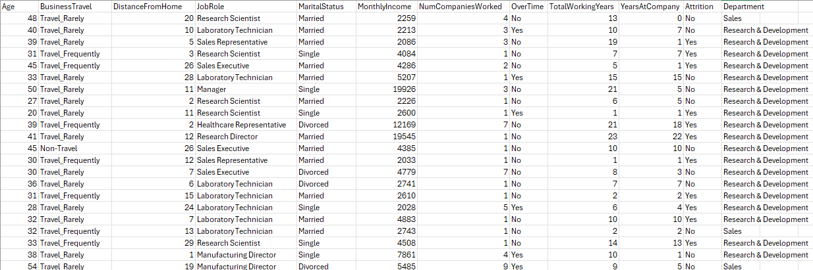
DATA SET
In this project, we explored the application of artificial intelligence in solving real-world HR problems.
The dataset used contains details about employees, such as job role, department, salary, tenure, distance from home, marital status, and more.
These variables were used to train a predictive model which could estimate the risk of attrition for any given employee.

Slide 4
CODE
We use the load_data() function from AIProjekt.py to import the CSV file using pandas. This function reads the HR data into a DataFrame.
Irrelevant or redundant columns such as Age, DistanceFromHome, etc., are removed in the clean_data() function to reduce noise.
Missing values are filled with either the median or mode, depending on the nature of the column.
The encode_categorical() function uses LabelEncoder() to convert categorical values into numerical representations.

Slide 5
CODE
feature_engineering() creates new columns derived from existing ones. For example:
LoyaltyIndex = YearsAtCompany / TotalWorkingYears
ExperienceLevel = Categorized TotalWorkingYears as Junior, Mid, or Senior
IncomePerYearWorked = (MonthlyIncome * 12) / TotalWorkingYears
These derived features add domain knowledge into the data, which improves model understanding.

Slide 6
CODE
The train_model() function splits the data using train_test_split() and applies a RandomForestClassifier with class_weight='balanced' to counter class imbalance.
Model performance is evaluated using accuracy score, classification report, and confusion matrix.
Artifacts like the model and test predictions are saved using joblib.dump() for reuse.

Slide 7
CODE
The generate_report() function in reports.py compiles visual plots and performance metrics into a PDF using PdfPages from matplotlib.
It includes summary statistics, histograms, heatmaps, confusion matrix, classification report, and final accuracy.

Slide 8
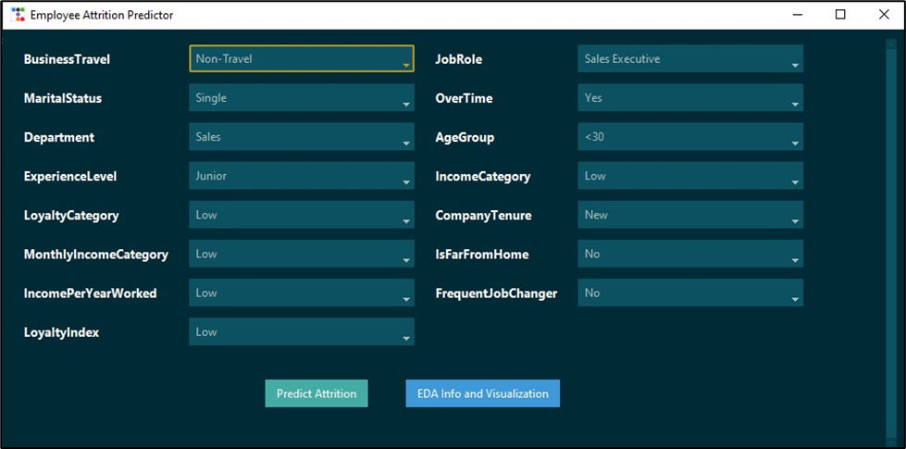
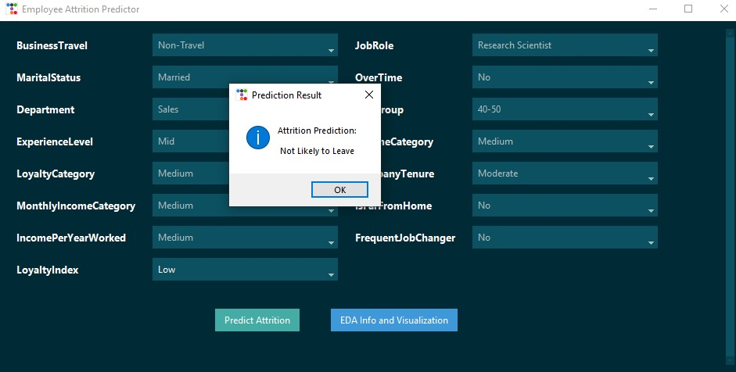
OUTPUT/SCREENSHOTS

Slide 9
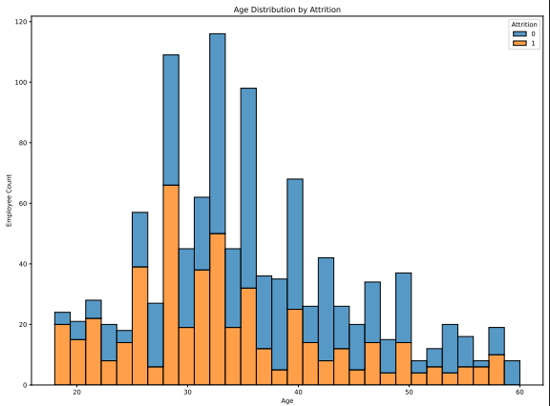
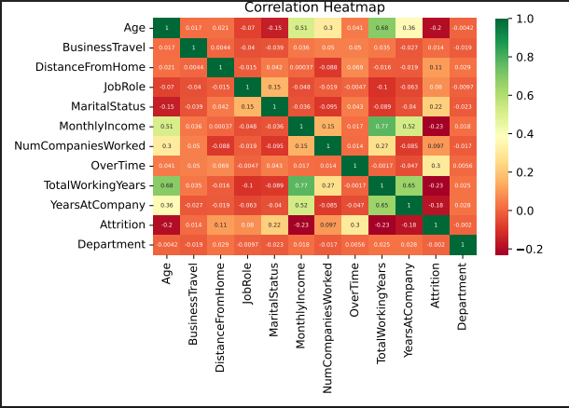
REPORT

Slide 10
CONCLUSION
This AI-powered program provides a complete solution for analyzing and predicting employee attrition.
By combining machine learning, feature engineering, and a user-friendly GUI, it offers actionable insights to HR professionals.
The program does not limit itself to an attrition predictor with good accuracy, but it also provides deeper understanding of the factors affecting it through visual tools and automated reports.

Slide 11
THANKYOU

